Slide 1
Apex Creative Automotive Products
beyond automotive products
Contact Information: 2803 W 163rd ST Torrance, CA 90504 TEL: (310) 347-8599 www.apexautopro.com info@apexautopro.com | Boeing IDs Supplier: BEST: SSPN: Message Courier: | 3A4542 BE10361833 N1970322 1970322

Slide 2
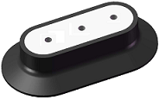
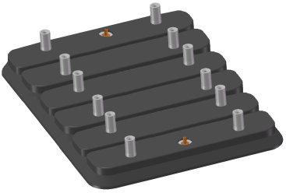
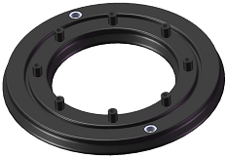
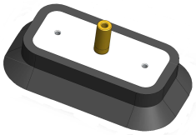
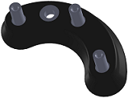
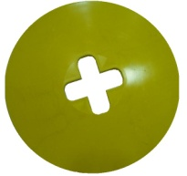
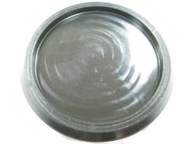
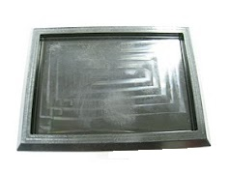
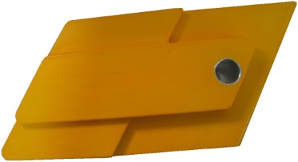
Silicon-Free, Chemical-Resistant Products
Vacuum Suction Cups (Rubber): 777X/787 Flex-Track Drilling
Protective Pads (Rubber): Anti-Slip & Protective Footing
FOD collecting Trays (Fire-Retardant Polyurethane): 787 Vacuum Drill

Slide 3
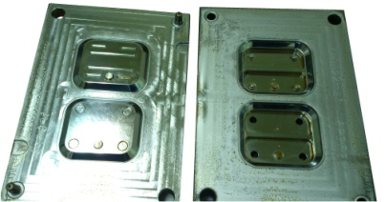
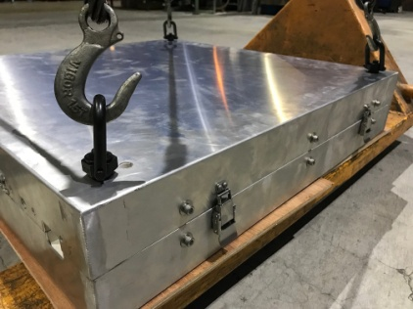
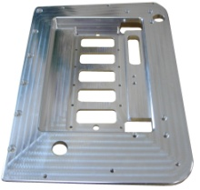
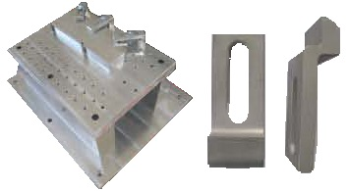
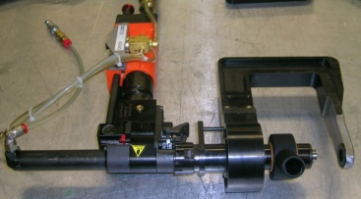
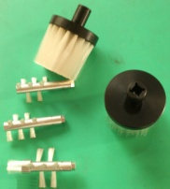
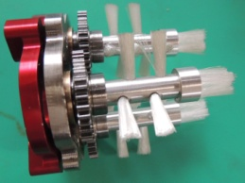
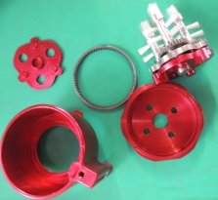
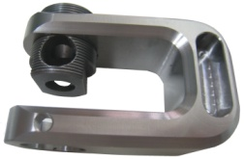
Precision Machining (Low Volume, Short Lead Time)
Compression/Injection/Thermal Molds | Drill Jigs, Tooling Fixtures
Power-Feed/ Hand-Held C-Clamps | Sealant Applicator

Slide 4
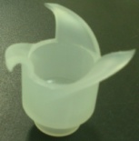
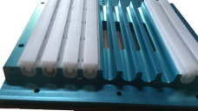
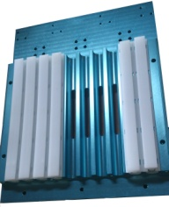
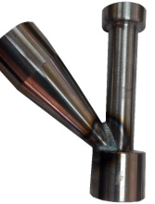
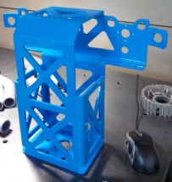
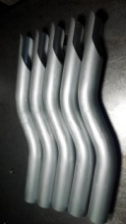
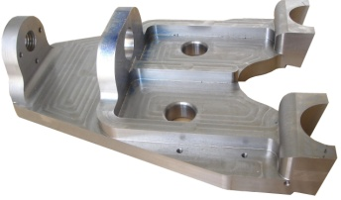
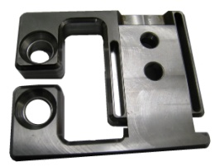
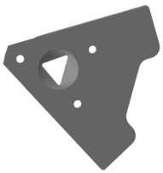
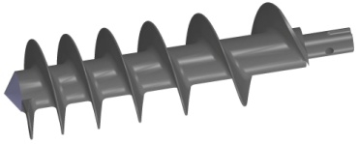
Precision Machining (Low Volume, Short Lead Time)
Teflon Coated Sealant Mold, Sealant Fairing | Tube Bending, Metal Weldment
Large Size Machining | EDMs (Wire/Sinker), Curved Surfaces

Slide 5
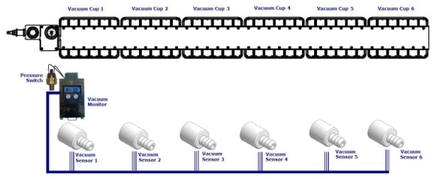
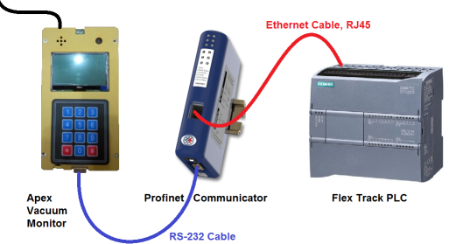
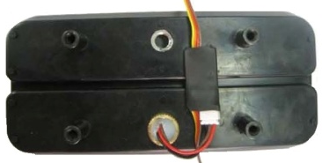
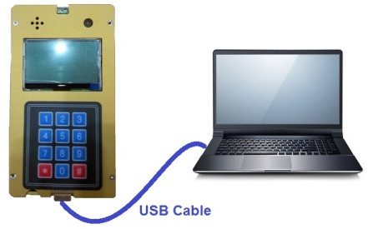
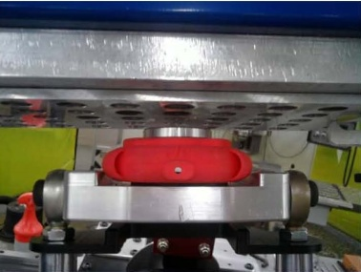
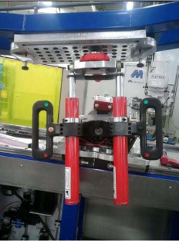
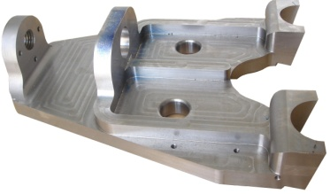
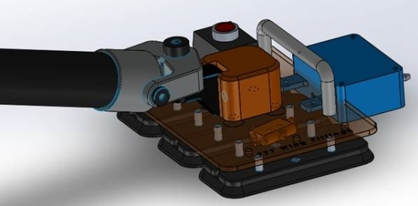
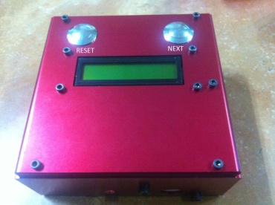
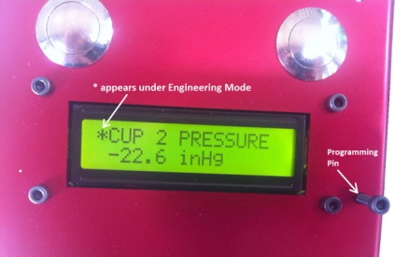
Add-On Turnkey System
Flex-Track Vacuum Monitoring System
Hydraulic Jig Controller
Torque Calibrator Vacuum Base & Monitoring System

Slide 6
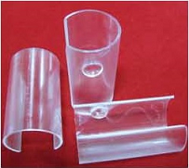
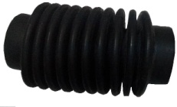
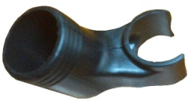
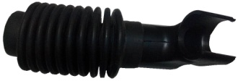
Mass-Production & Stocking Items
ST item: Spindle Guard Protective Cover, P/N: ST7020P-F-1 to ST7020P-F-6
* We stock all 6 sizes in California for immediate delivery
Silicon-Free Rubber Bellow: P/N: BELO-28MMID (Stocks available in California)

Slide 7
Equipment List and Maximum Sizes
Equipment (Qty) | Maximum Machinable Size
5-axis CNC (2) | Ø23” (Ø600 mm )
4-axis CNC (4) | Ø15.5” (Ø400 mm )
3-axis CNC (15) | 59*29.5*23” (1500*750*600 mm)
Horizontal Lathe (2) | Ø15.7*47.2” (Ø400*1200 mm)
EDM (Wire and Sinker, 2) | 10*10*12” (250*250*300 mm)
3D Printer (ABS and Nylon only, 1) | 12*12*10” (300*300*250 mm)
CMM (Coordinate Measuring Machine, 1) | 31.5*20*20” (800*500*500 mm)

